Slide 1

1
9
6
Let's Play
Sudoku!
4
8
7
5
2
3
8
4
Start
7
6
2
9
1

Slide 2
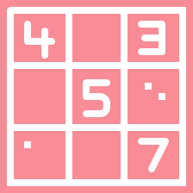


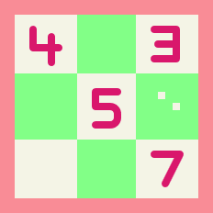
Let's Play Sudoku!
Players
3
Saurav Gaudel(081BCT074)
Sudip Shrestha(081BCT084)
Yogendra Sharma Upadhaya(081BCT094)
9
2

Slide 3
What is SuDoKu?
Sudoku is a very popular number puzzle game that is played on a 9×9 grid.
The main objective is to fill the grid so that every row, column, and each of the nine 3×3 sub-grids contain all the digits from 1 to 9 without repetition.
3

Slide 4
How to play Sudoku?
Here are very simple rules on how to play Sudoku!
1
Every square has to contain a single number
2
Only the numbers from 1 through to 9 can be used
3
Each 3×3 box can only contain each number from 1 to 9 once
4
Each vertical column can only contain each number from 1 to 9 once
5
Each horizontal row can only contain each number from 1 to 9 once
4

Slide 5
S
8
1
9
4
2
5
7
6
6
4
9
5
1
8
O
2
5
6
9
1
U
7
9
1
3
4
5
5
2
4
1
K
1
8
4
6
3
2
9
2
8
1
9
7
D
6
4
1
7
8
5
U
4
6
5

Slide 6
Objectives
To design and implement an interactive Sudoku game in C++
To apply Object-Oriented Programming (OOP) principles
To use SFML library for graphical user interface (GUI)
To make a fun, engaging, and educational puzzle game
6

Slide 7
Features
User login & new user creation
Level selection system (locked/unlocked)
Score and diamond reward system
Timer & difficulty setting
SFML-based graphics & UI
An automated solving algorithm (e.g., backtracking),
A modular class-based structure.
7

Slide 8
Literature Survey
Many Sudoku games exist (mobile apps, online websites)
Most use:
Simple console versions (text-based Sudoku)
Graphical versions with libraries like Java Swing, Python Tkinter, Unity...
Our work:
Uses C++ with SFML, a relatively lightweight multimedia library
Adds user login, progress saving, rewards system, diamond penalties for incorrect moves, timed gameplay.
8

Slide 9
Methodology
Requirement Analysis – Define features: input, validation, solver, GUI.
System Design – Use OOP with modular classes (User, Level, Menu, SudokuGame).
Interface & Algorithm – Build GUI in SFML and implement backtracking solver.
Integration & Testing – Combine modules, test usability, handle errors.
9

Slide 10
Implementation
Tools & Architecture: C++ with SFML 3.0; modules for User Management, Sudoku Logic, Menu, and UI.
Game Logic & Algorithms: Backtracking board generation, puzzle difficulty, real-time input validation, scoring, diamonds, and timer.
OOP & Class Design: Classes: User, Menu, SudokuGame; demonstrates encapsulation, modularity, and function separation.
File Handling & UI: Users’ progress stored in users.txt; UI shows board, score, diamonds, timer, and interactive feedback.
10

Slide 11
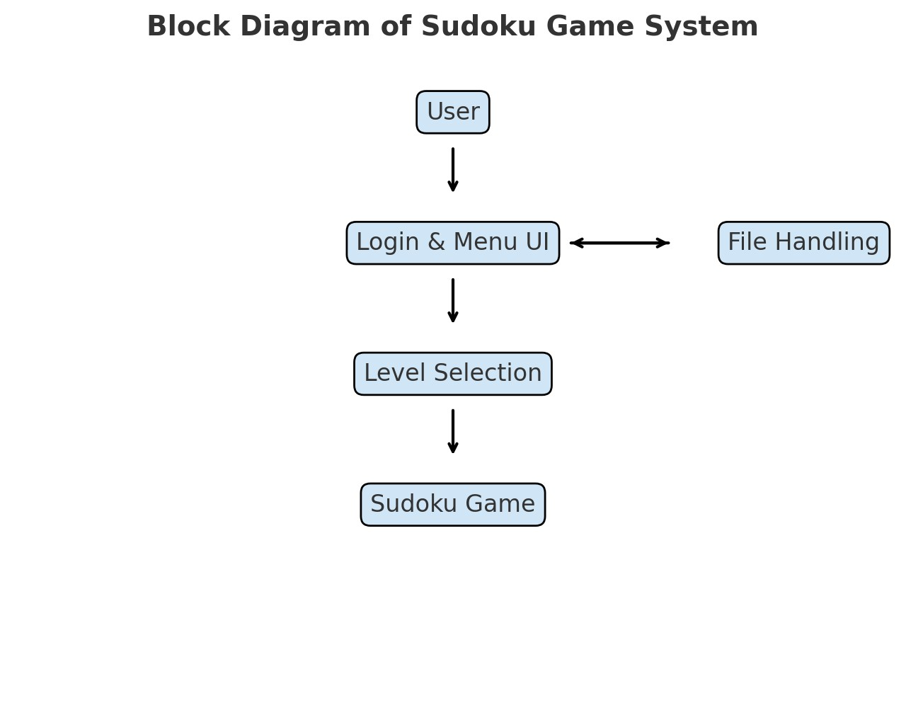
11

Slide 12
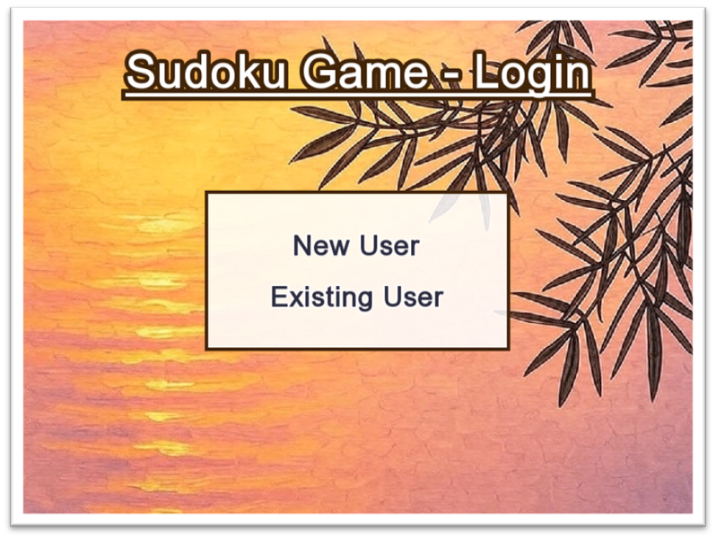
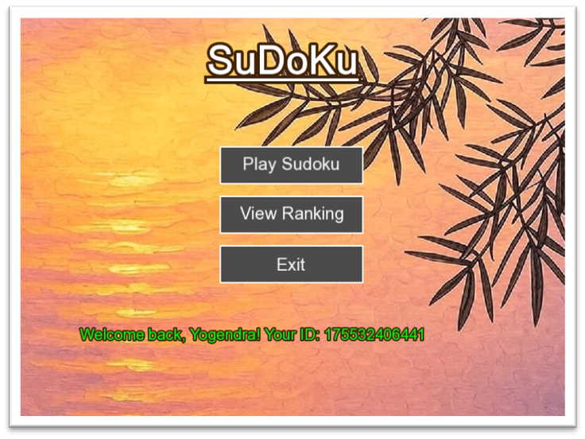
Results
12

Slide 13
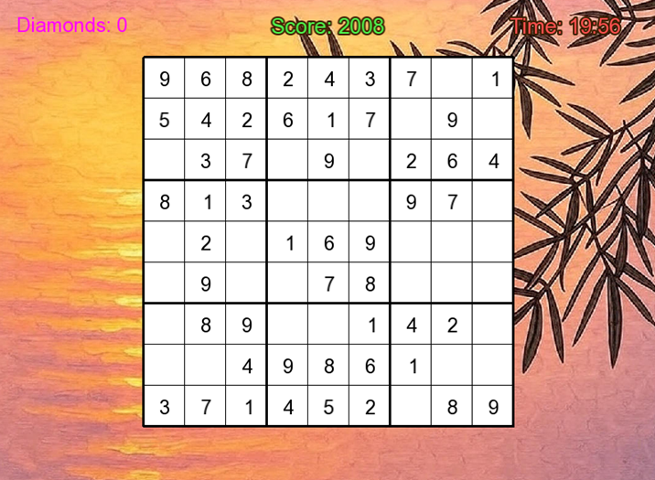
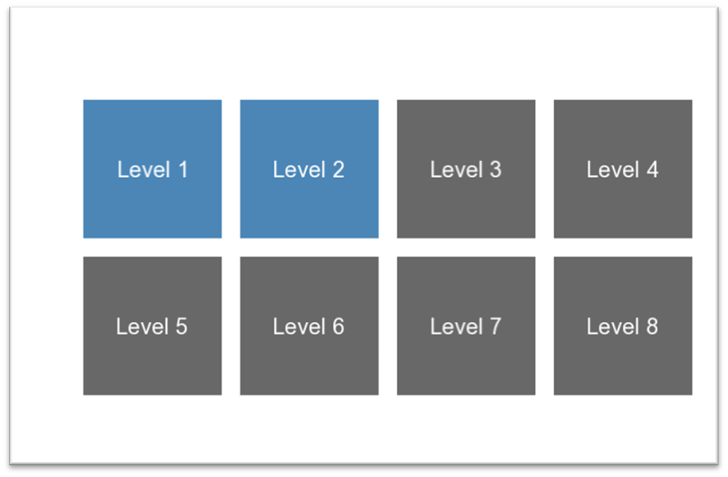
13

Slide 14
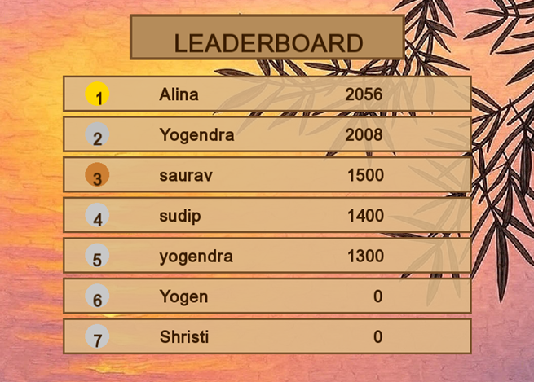
14

Slide 15
Problem Faced and Solutions:
Challenges:
Learning SFML 3.0.0 with limited tutorials.
Implementing backtracking algorithm for Sudoku generation.
Handling user data (scores, diamonds, levels) with persistence.
Integrating timers, input validation, and real-time gameplay.
15

Slide 16
Problem Faced and Solutions:
Solutions:
Studied official SFML docs and experimented with graphics/events.
Implemented and debugged backtracking step by step.
Designed a file-based user management system.
Used modular OOP design for clean and maintainable code.
16

Slide 17
Limitations
Limited to 9×9 grid with predefined difficulty levels.
Basic UI in SFML, lacking advanced visuals or animations.
Supports only single-player mode with local file storage.
Missing features like undo, hints, and flexible scoring system.
17

Slide 18
Future Enhancements
Support for different grid sizes and adaptive difficulty levels.
Improved UI with animations, effects, and sound.
Add multiplayer mode, online leaderboards, and flexible scoring.
Use database storage and include undo/redo & hints for better gameplay.
18

Slide 19
Conclusion
Our project successfully developed a graphical Sudoku game with an interactive interface. It not only provides entertainment but also improves logical thinking and problem-solving skills. This project enhanced our programming knowledge and teamwork experience.
19

Slide 20
thank
you
20

